Slide 1

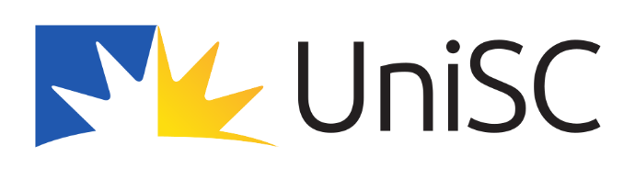

SAMR
Dr Emily Ross The University of Queensland emily.ross@uq.edu.au | Dr Margaret Marshman University of the Sunshine Coast mmarshma@usc.edu.au | Dr Natalie McMaster University of the Sunshine Coast nmcmaste@usc.edu.au

Slide 2
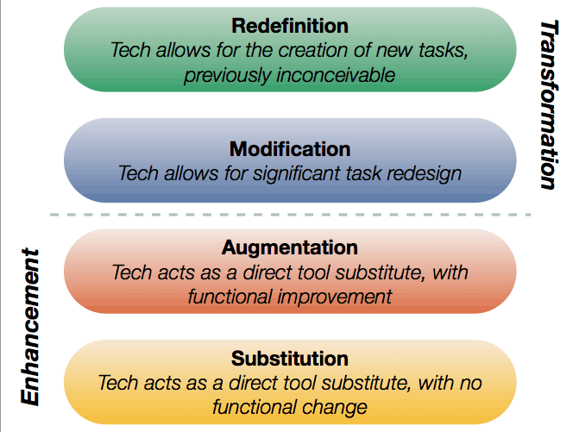
STEM in Mathematics and Digital Technology
CRICOS code 00025B
Integration of digital technologies: SAMR
The distinction between modification and redefinition often depends on the depth and breadth of technology integration in the lesson plan not necessarily the technology used.
Notes:
SUBSTITUTION – Technology acts as a direct tool substitute, with no functional change. For example, students may type up notes on a word processor instead of writing by hand in an exercise book.
AUGMENTATION – Technology still acts as a direct tool substitute, but with functional improvements. Taking the example of typing on a word processor, augmentation means that the learning process can become more efficient and engaging. Images can be added, text can be hyperlinked and changes to the text itself can be made quickly.
These first two stages of the SAMR model represent enhancements of existing ways of working. Digital technology is not necessary in order to carry out the learning task. The technology simply provides a digital medium for learning to take place, which may enhance learning.
MODIFICATION – By this stage technology not only enhances the learning activity, it also significanly transforms it. An example might be students setting up a blog in which they open up their work to a worldwide audience. The blog means that students are much more accountable for the work they present, so will tend to spend more time refining their written work. In this way, both student learning and literacy improve.
REDEFINITION – This level requires the teacher to think about learning activities that were previously inconceivable without the use of technology. This could be for instance, a Google Hangout session that takes place between students from different countries in order for students to swap information about their home countries in real-time. Likewise, the use of Google Docs for students in different parts of the world to collaborate on a shared assignment facilitates learning opportunities that would be impossible without such technology.
The modification and redefinition levels represent transformational stages in terms of student learning, as the technology is actively helping to transform the way in which learning can occur.

Slide 3
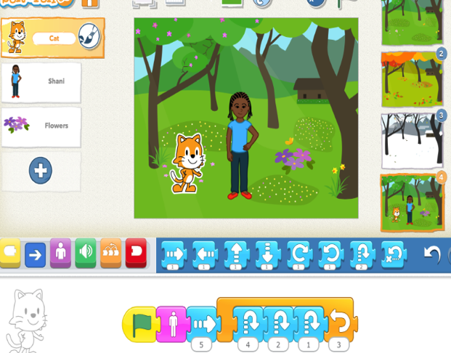
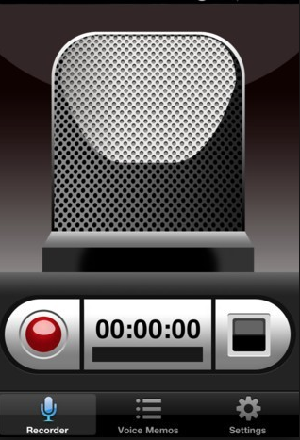
STEM in Mathematics and Digital Technology
CRICOS code 00025B
Year 2 English Curriculum Example
SAMR | Prepare and deliver an oral presentation titled ‘All About Me’
Redefinition | Use Scratch Jnr to program an animation with voice and sound recordings
Modification | Create an interview with an expert which includes video, voice recording and uses green screen
Augmentation | Inserting pictures into PowerPoint and graphics
Substitution | Record oral presentation on a voice recorder
Notes:
Many teachers are still working ‘below the line’ and this can be due to many things – e.g. teacher confidence and skills in technology, access to resources and technology, student needs and abilities in the class
The aim is for teachers to be working ‘above the line’ using technology to transform learning

Slide 4
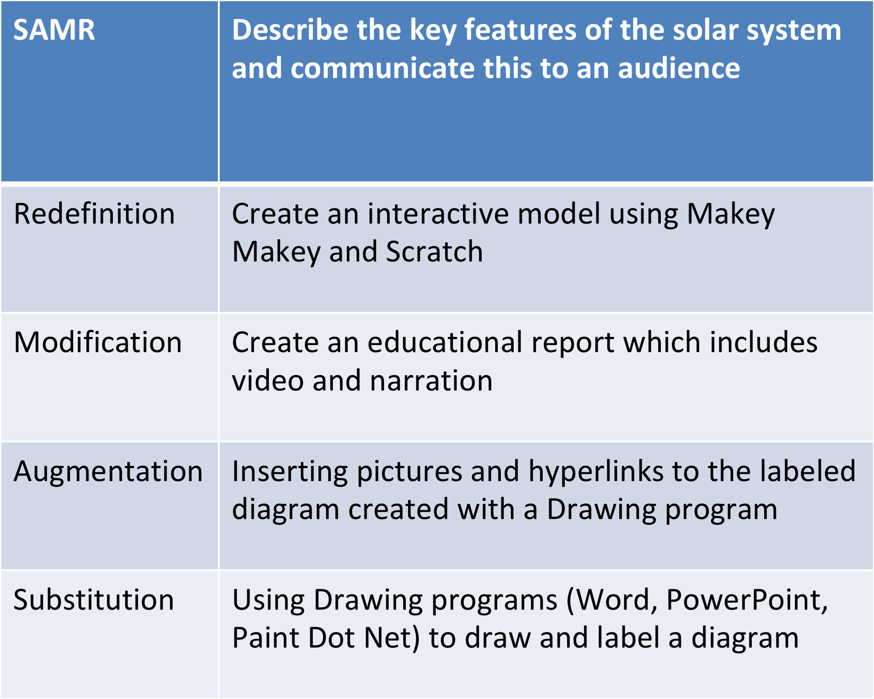
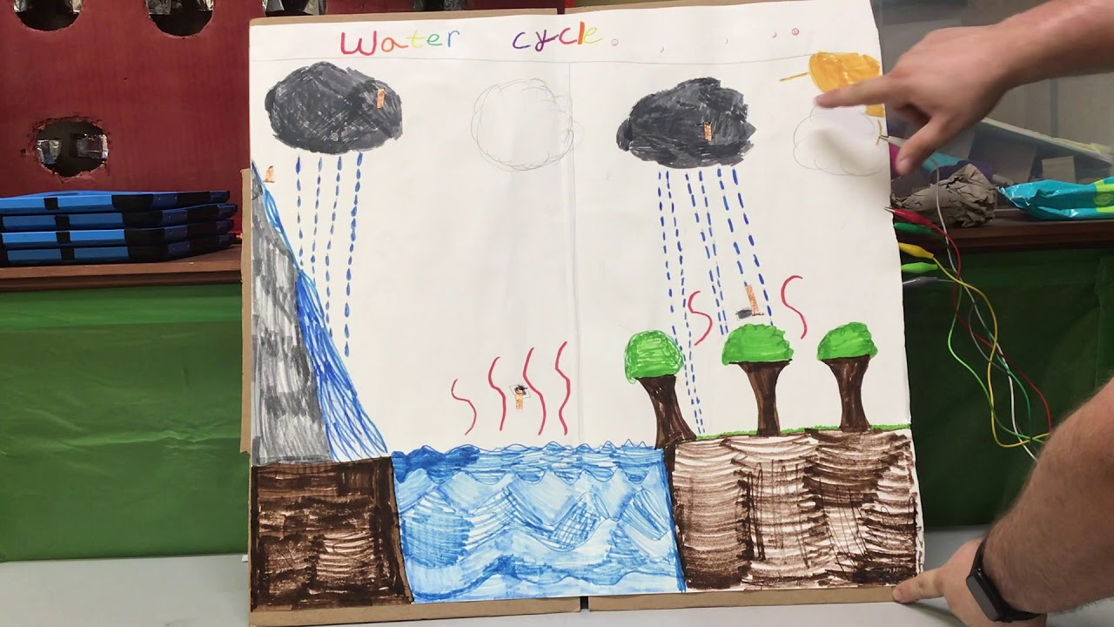
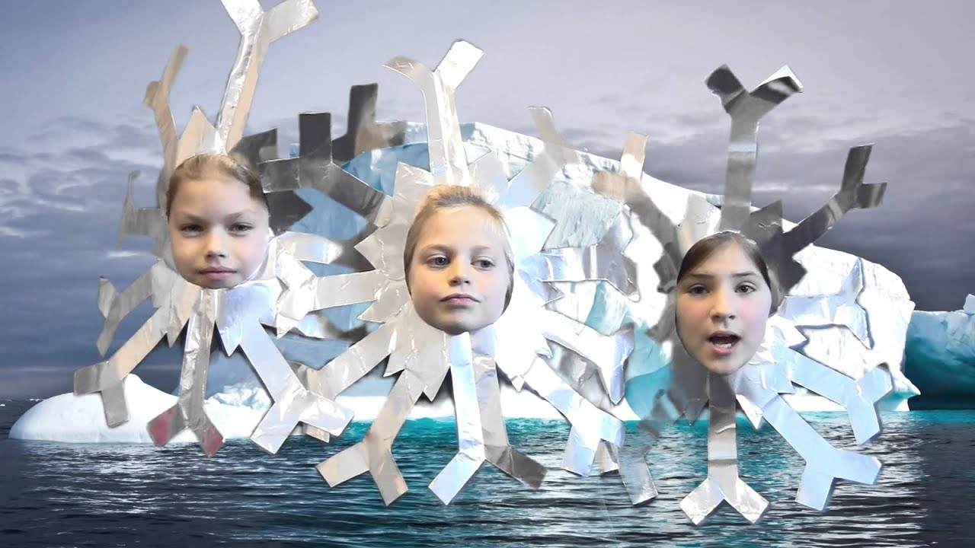
STEM in Mathematics and Digital Technology
CRICOS code 00025B
Year 4 Science Curriculum Example
Notes:
Working above the line, also means that students learn new technology skills which are relevant to their lives and are transferable skills

Slide 5
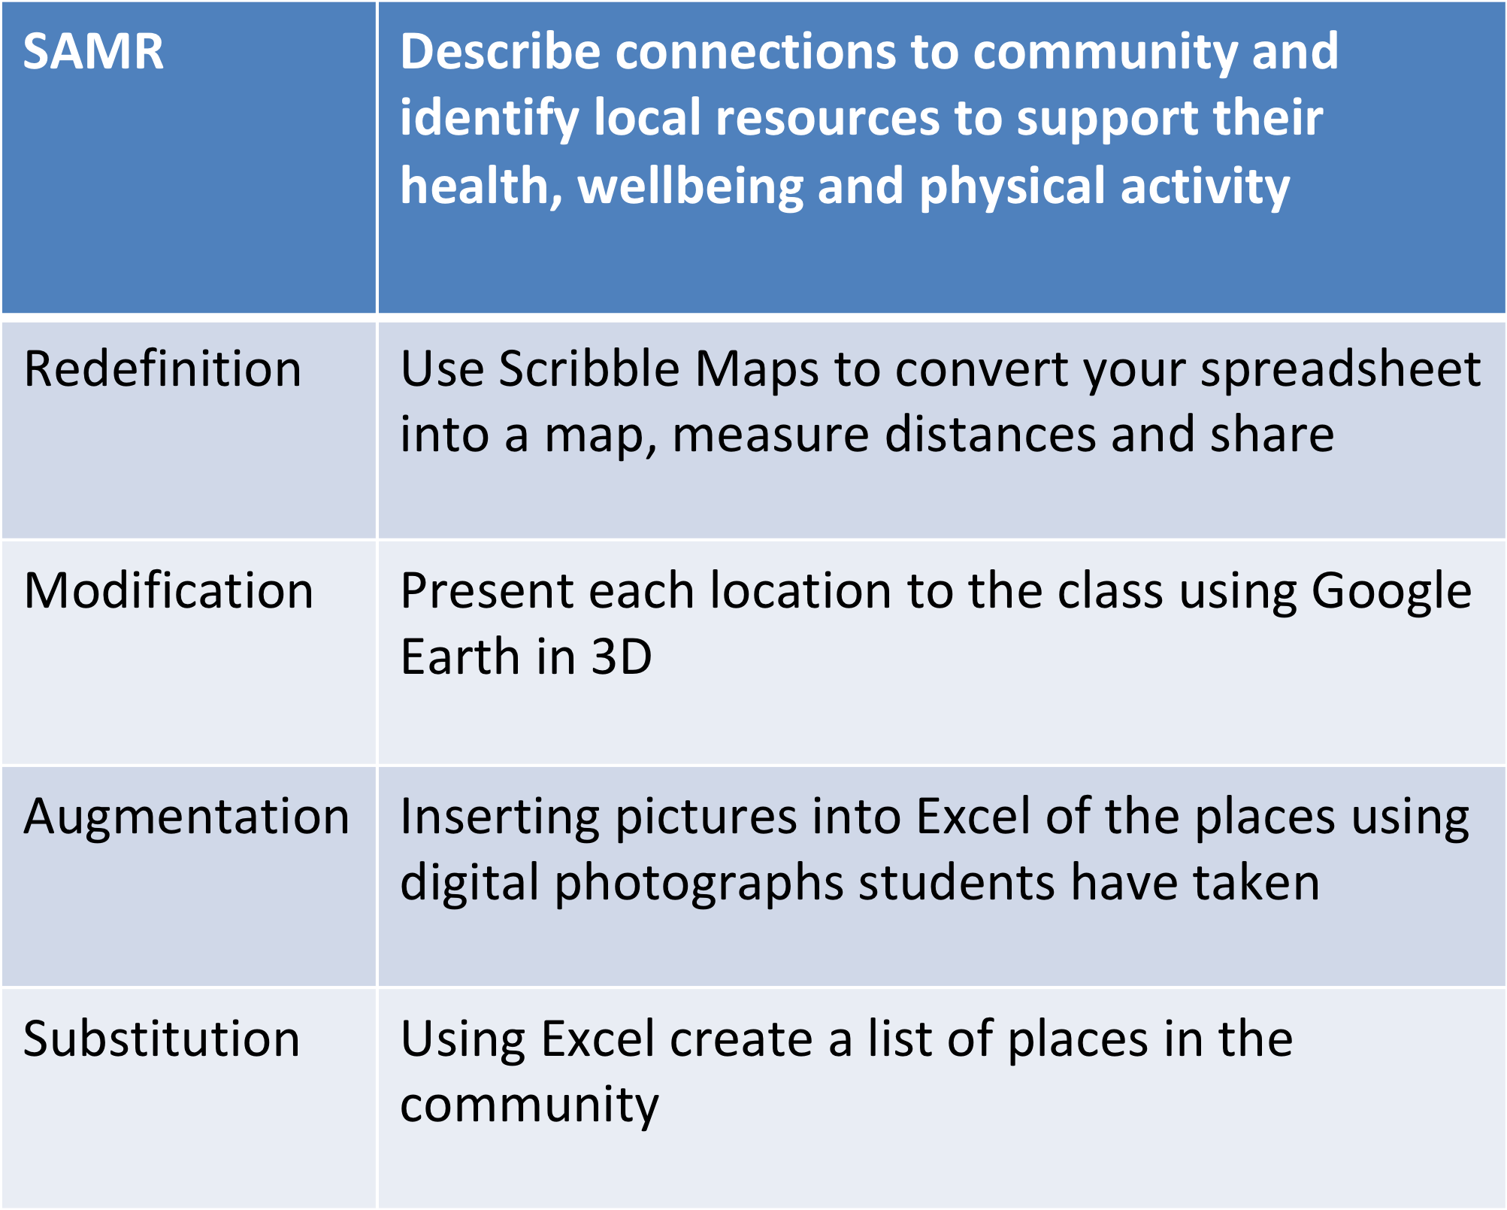
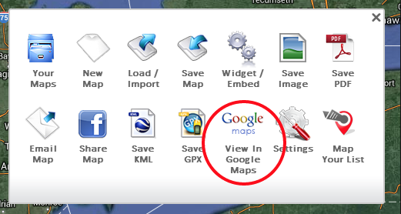
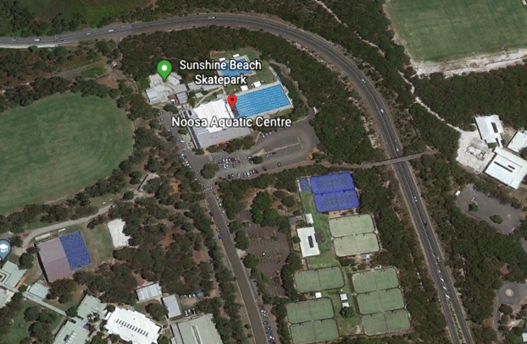
STEM in Mathematics and Digital Technology
CRICOS code 00025B
Year 4 HPE Curriculum Example
Notes:
Google Earth and Scribble Maps are very simple and easy to use and free, all students need is access to a computer and the internet

Slide 6
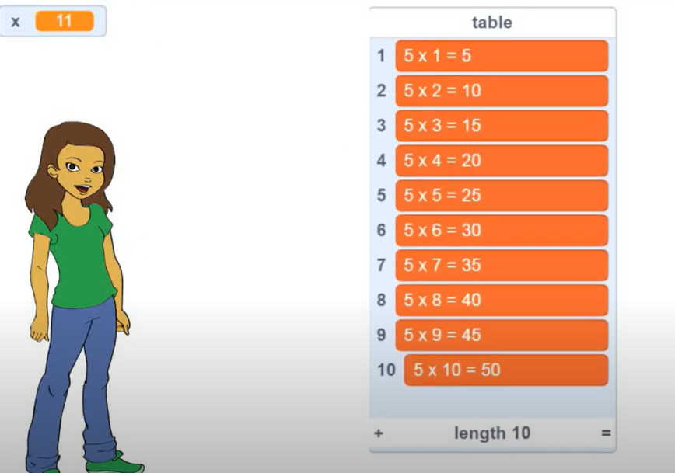
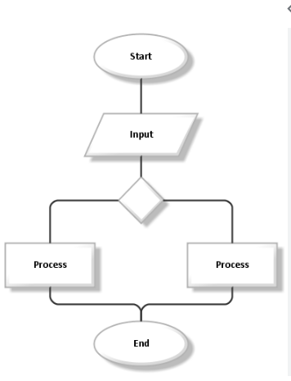
STEM in Mathematics and Digital Technology
CRICOS code 00025B
Year 4 Maths Curriculum Example
SAMR | Follow and create algorithms involving a sequence of steps and decisions that use multiplication to generate sets of numbers; identify and describe any emerging patterns
Redefinition | Create a multiplication machine using a Microbit to help younger students learn their multiplication tables
Modification | Program a multiplication table game in Scratch and play it with others
Augmentation | Use Excel “fill down” function using a multiplication formula to generate a multiplication table
Substitution | Use a flow chart template in Word to represent an algorithm that will generate a sequence of numbers
Notes:
Scratch create a multiplication table https://youtu.be/3_MApybsUBU?si=-05Pi1KU-HjC8p9l
Integrate maths with Microbit https://skoolofcode.us/blog/how-to-integrate-math-with-microbit/ - students transformational learning in a hands on manner introduces them to the basics of coding and electronics, promotes problem-solving and creative thinking
The distinction between modification and redefinition often depends on the depth and breadth of technology integration in the lesson plan. If the micro:bit is being used to push beyond the boundaries of traditional learning activities and enable students to engage in creating new, innovative projects or solving real-world problems in ways they couldn't before, it's more likely to be considered as "Redefinition".

Slide 7
STEM in Mathematics and Digital Technology
CRICOS code 00025B
Your turn – in small groups
Select a year level
Select a maths content description
Think about a traditional task without technology
Is there a technology which could be substituted for the task but does not make any changes to the task?
Next think about a technology which could be used to keep the task the same but create some functional improvements?
Now work ‘above the line’. The learning in the task is now transformed using technology in ways that are not possible without its use
Be ready to justify your examples
SAMR
Redefinition
Modification
Augmentation
Substitution
Notes:
You could use the last task you designed and see where you think it fits in the SAMR model. How could you modify the task further to be working at a transformational level?

Slide 8
Remember:
SAMR levels are a teacher decision, depending on your learning outcomes, your students, your access to technology, your confidence, and support.
Notes:
A teacher’s ability to integrate at a transformational level depends largely on their TPACK – knowledge of curriculum, resources, pedagogy and technologies
A basic level of understanding or knowledge can still result in working at a transformational level, depending on the depth and breadth of technology integration in the lesson plan.

Slide 9
Thank you

